Slide 1
Maximum Bipartite Matching
and
Maximum Flow
Erik Senekal

Slide 2
Example Problem
There are people and cars. Each person likes some of these cars. A person can buy at most one car and each car can be bought at most once. If a person buys a car they like, they are happy. What is the maximum number of people that can be happy?

Slide 3
What is a bipartite graph?
A graph is bipartite if its vertices can be divided into two sets, such that there does not exist an edge between vertices in the same set.

Slide 4
Analysis of Problem
This problem can be represented as a graph like the one on the right.
Each edge represents a person liking a certain car.
We now have to determine the maximum number of edges such that no vertex is the endpoint of more than one used edge.
Note that this graph is bipartite since people aren’t connected to people and cars aren’t connected to cars.

Slide 5
What is a bipartite matching?
Given a graph, a matching means to choose a subgraph such that no vertex has more than one edge.
A bipartite matching is a matching in a bipartite graph.
The maximum bipartite matching is the bipartite matching with the maximum number of edges.
Note that solving the maximum matching problem in a general graph is NP-hard.

Slide 6
Maximum flow problem
Consider the following scenario:
There are some islands, one of which is the starting island or source and one of which is the destination island or sink. Bridges connect these islands with each other, but each bridge can be crossed only a certain number of times before breaking. If there are an infinite number of people on the source island, what is the maximum number of people that can reach the sink island?
(Bridges can only be crossed in one direction.)

Slide 7
What is maximum flow?
The island problem described is the maximum flow problem.
We are given a weighted directed graph.
We want to send flow, from the source to the sink. The flow is represented by people in our scenario.
Each vertex represents an island.
The number of people going off the source island must also be the number of people going onto the sink island, else some will be stranded.

Slide 8
How do you solve the maximum flow problem?
We see that each edge represents the number of times that the edge can be part of a path from source to sink. We call this the remaining capacity of the edge.
For each edge we add another edge in the opposite direction and with an initial weight of 0. These edges represent the number of times the original edge has been used in a path from the source to the sink. We call this the flow of the edge.

Slide 9
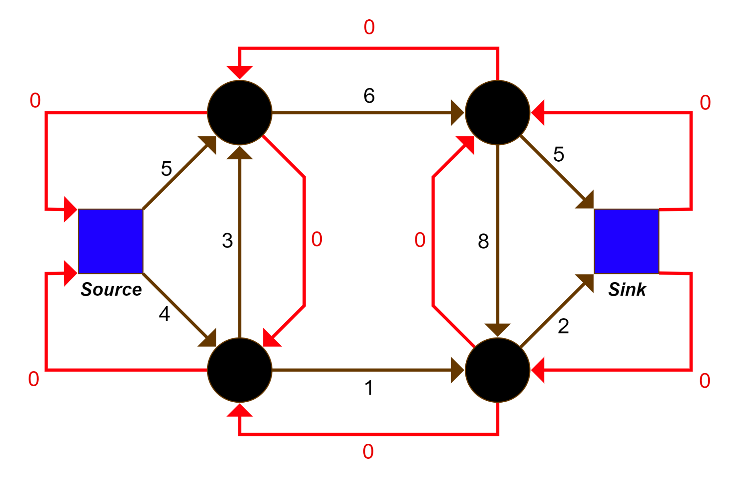
How do you solve the maximum flow problem?
We can now see the flow edges have been added in red, and people can start going on a path from the source to the sink.
If we can find a path from the source to the sink such that all the weights are positive, some people can walk from the source to the sink. This is called an augmenting path.
The number of people that can walk on this path, is the minimum weight on the path, otherwise a bridge would have broken.

Slide 10
How do you solve the maximum flow problem?
So when such a path is found, all the edge weights on the path is decreased by the minimum value on the path. This is because the remaining capacity of the bridges are now less.
The reverse edge is increased by the minimum weight on the path since the flow over each bridge has increased.
If no path is found the process is finished.

Slide 11
How do you solve the maximum flow problem?
The question of how to find these augmenting paths still remains.
It turns out that simple DFS or BFS works well enough.

Slide 12
But why does this work?
This algorithm is called Ford-Fulkerson and it is guaranteed to work because reverse edges can also form part of the paths.
If at any point we did not route the flow optimally, the reverse edges guarantee that this action is reversible.
If we continue the process of finding augmenting paths, we eventually find the maximum flow.

Slide 13
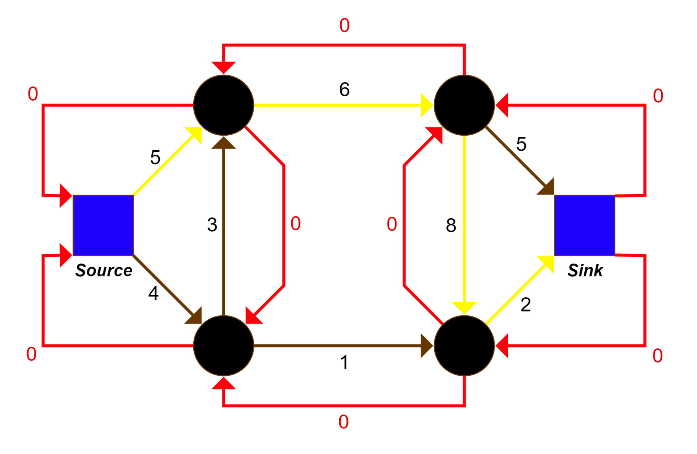
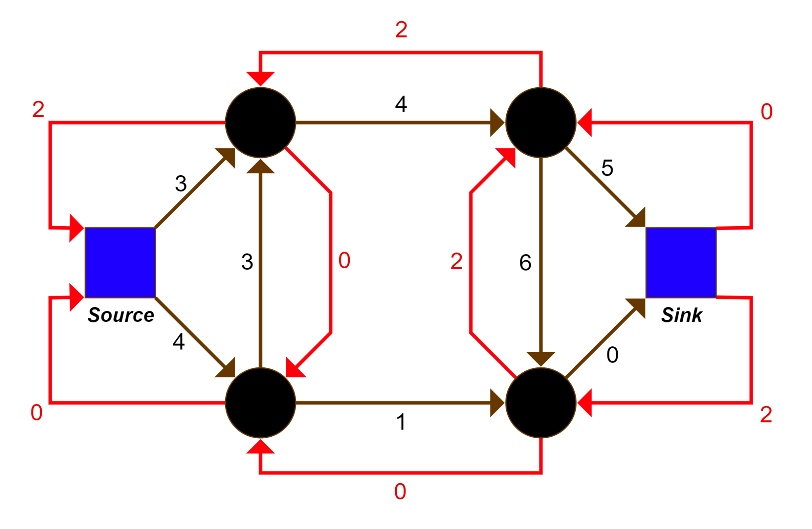
Let’s see Ford-Fulkerson in action.
Augmenting paths are highlighted in yellow.
Step 1

Slide 14
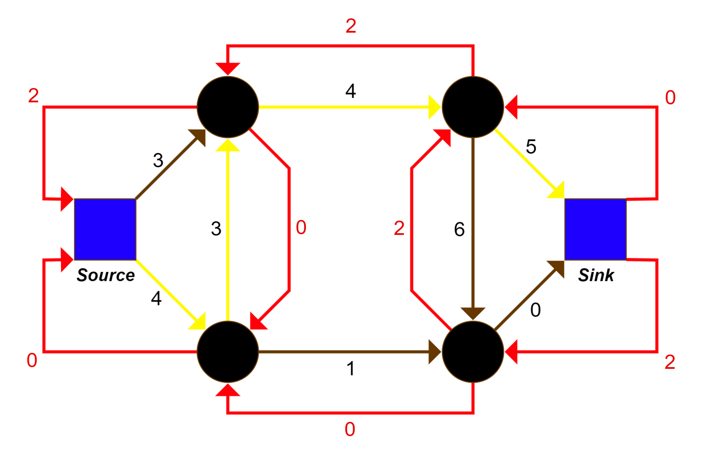
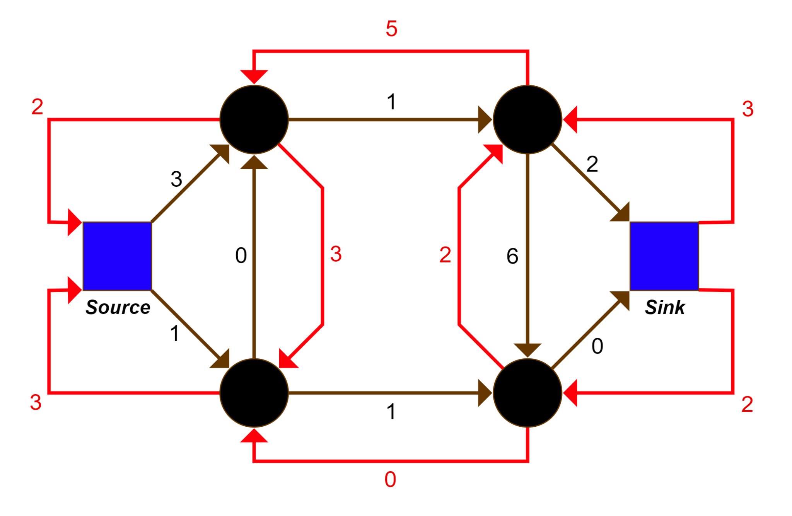
Let’s see Ford-Fulkerson in action.
Augmenting paths are highlighted in yellow.
Step 2

Slide 15
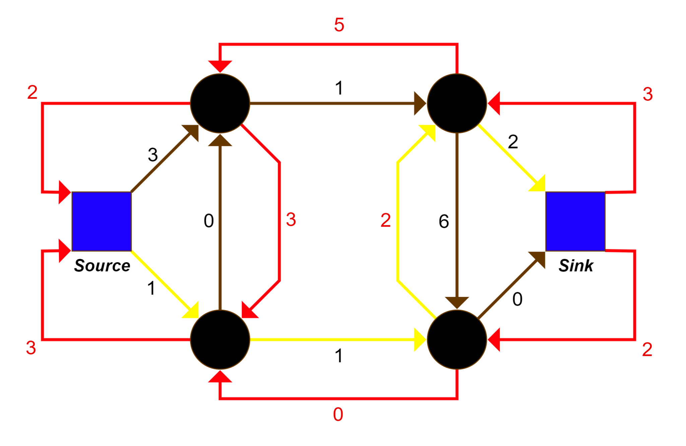
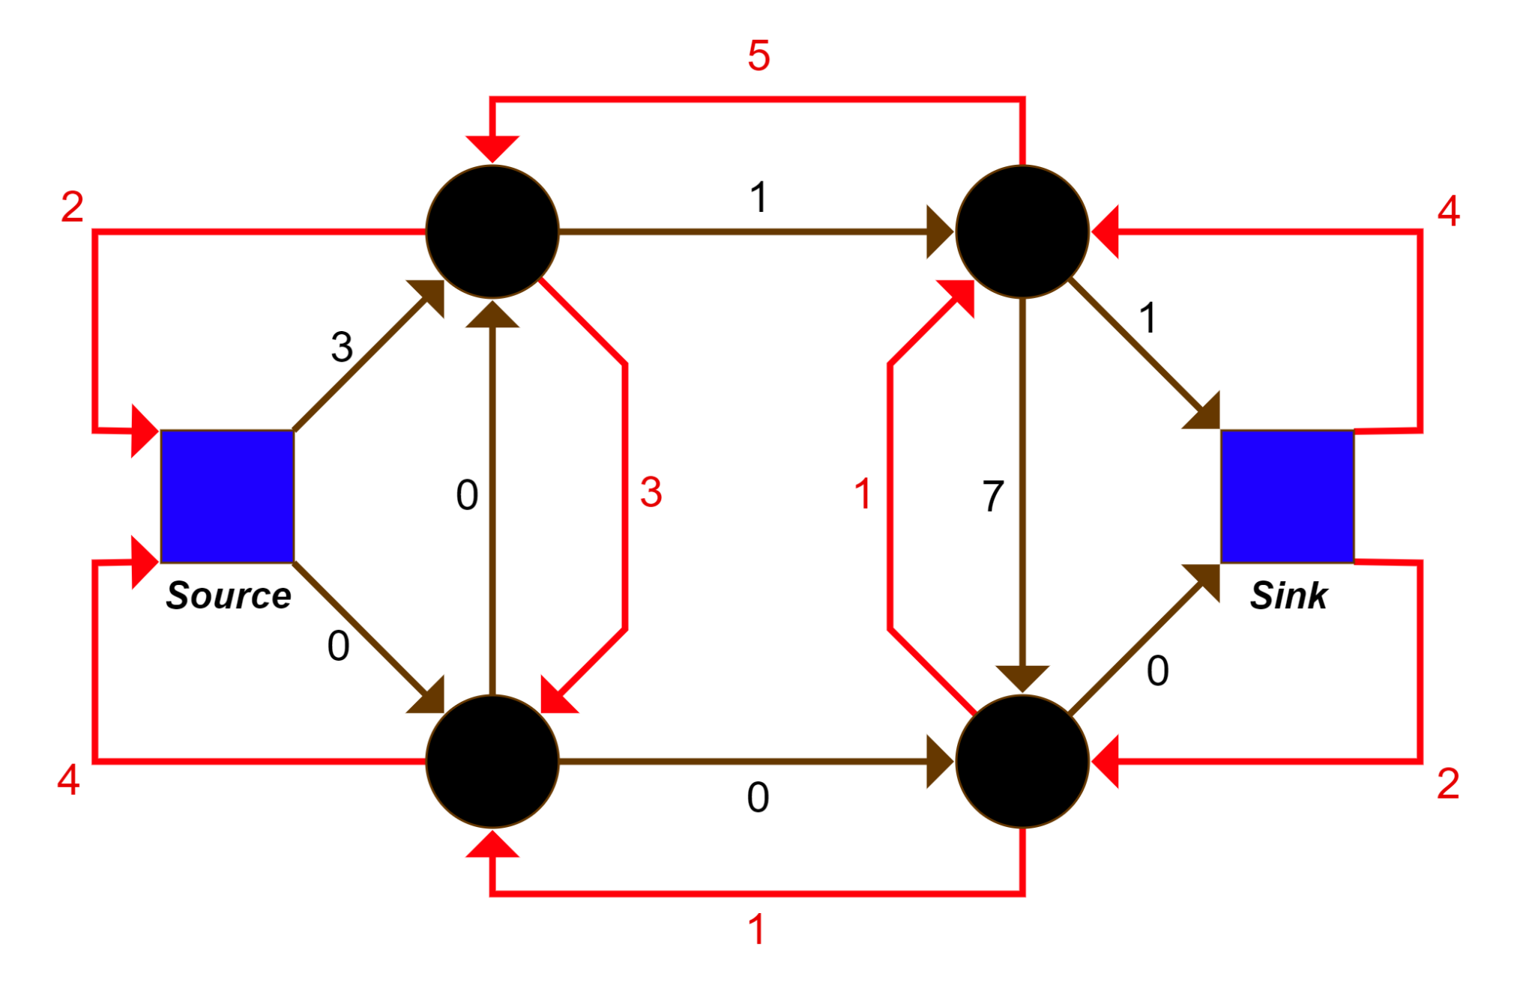
Let’s see Ford-Fulkerson in action.
Augmenting paths are highlighted in yellow.
Step 3

Slide 16
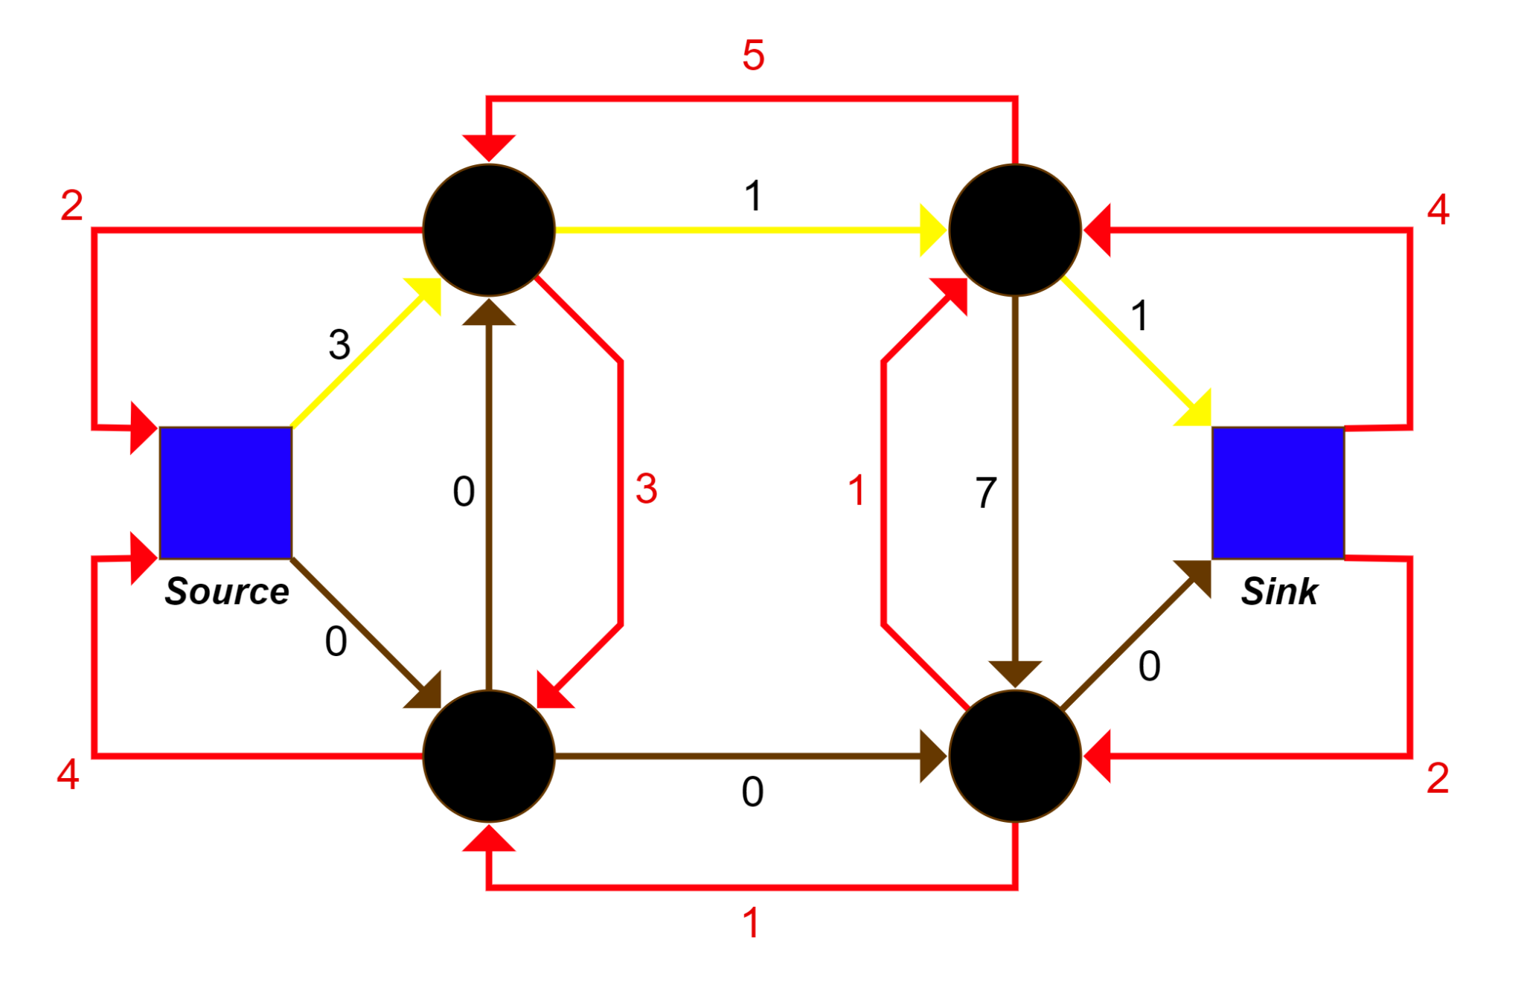
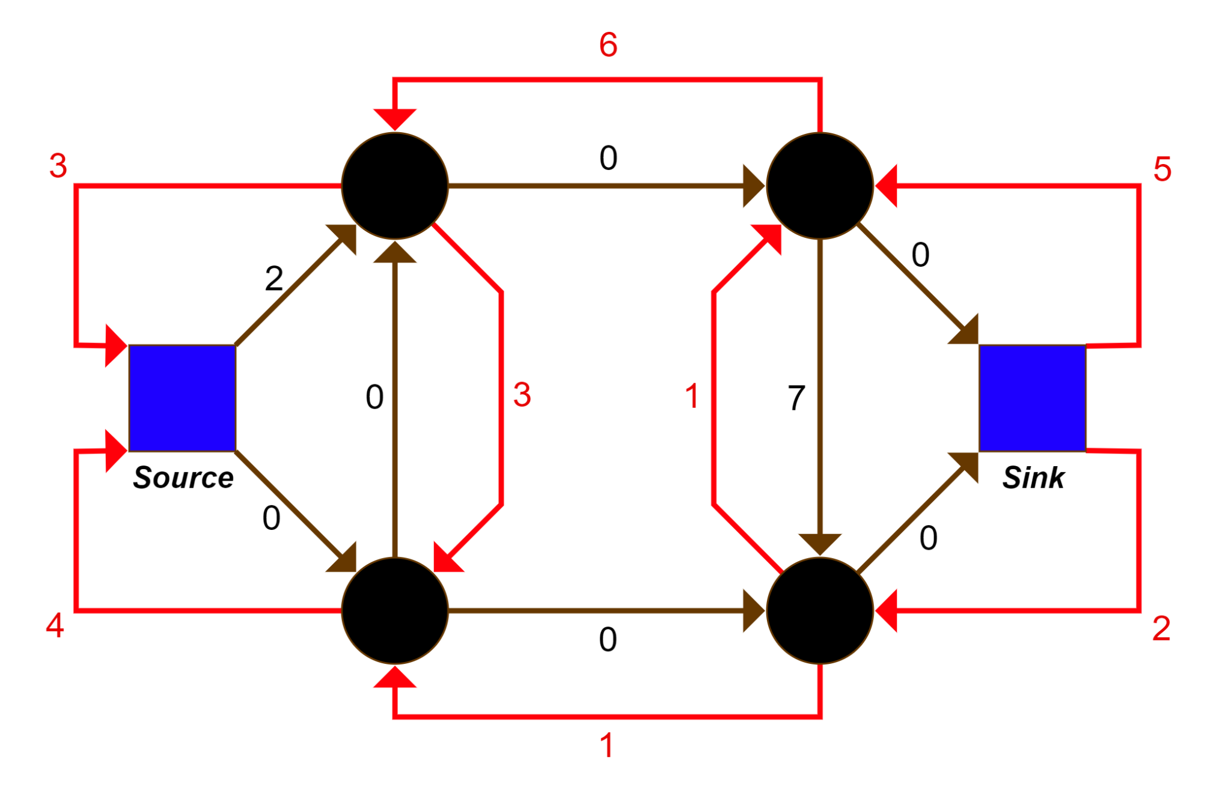
Let’s see Ford-Fulkerson in action.
Augmenting paths are highlighted in yellow.
Step 4

Slide 17
Final Graph
No more augmenting paths can be found in this graph and we are done with the process.
We can now see the maximum flow will be the total flow out of the source node.
The maximum flow is thus the sum of the weights of all the reverse edges connected to the source.
This is equal to 3 + 4 = 7.

Slide 18
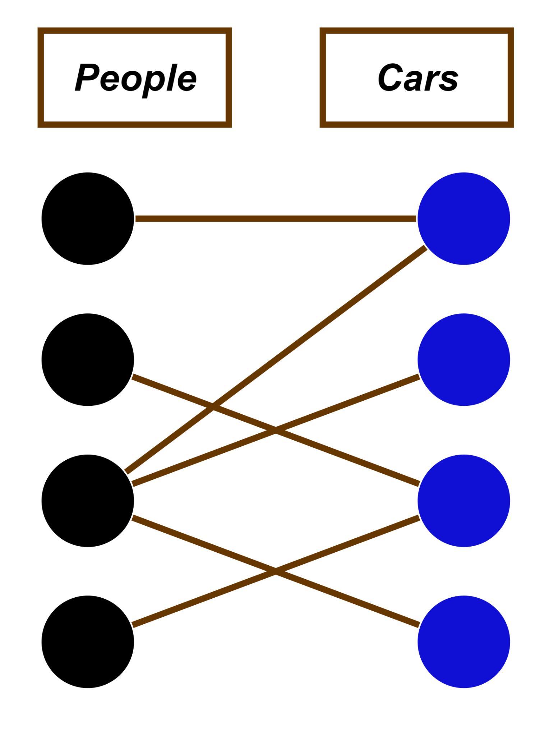
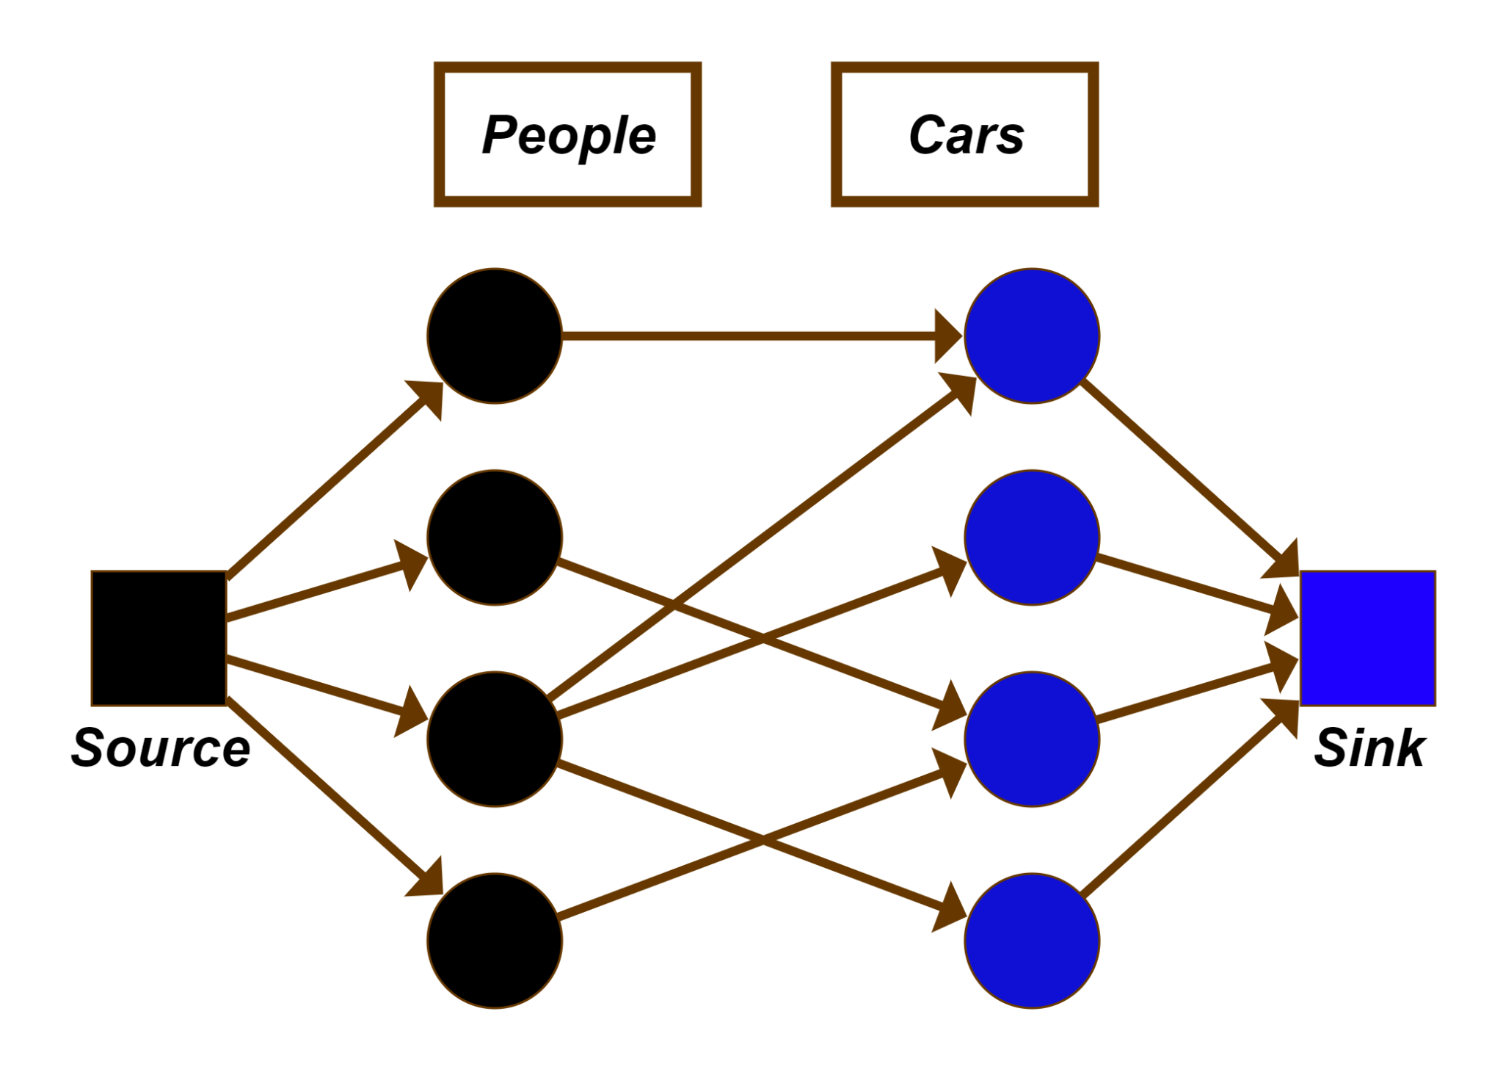
How is maximum flow related to maximum bipartite matching?
We can convert the maximum bipartite matching problem into the maximum flow problem where each edge weight is 1 as follows:

Slide 19
How is maximum flow related to maximum bipartite matching?
Since there is only one way to get from the source to a person, and also only one way to get from a car to the sink, the flow through each node can be at most one in the maximum flow problem.
The maximum flow will also be equal to the number of people-to-cars edges through which the flow propagates.
The maximum flow is thus equal to the maximum bipartite matching.

Slide 20
Analysis of Time Complexity
Each DFS will run in O(V+E) and each DFS will find an augmenting path, otherwise we have found the maximum flow. The maximum flow can never be greater than the number of vertices. Since each augmenting path increases the current flow by one we have the total time complexity of O(V(V+E)) = O(V²+VE)= O(VE).
This time complexity is sought in the IOI syllabus.

